Slide 1
Suffragists of Duxbury
Lyle Nyberg
February 2, 2021
Zoom presentation for
Duxbury Rural & Historical Society

Slide 2
Thank you
Duxbury was home to nationally significant suffragists – Smiths & Moores
How I got here
Scituate history → Duxbury connections
2019 DRHS, Drew Archival Library → Summer Suffragists book
2020 DRHS Zoom talk → descendant of Sylvanus & Judith Smith
Later research → shipbuilders of East Boston

Slide 3
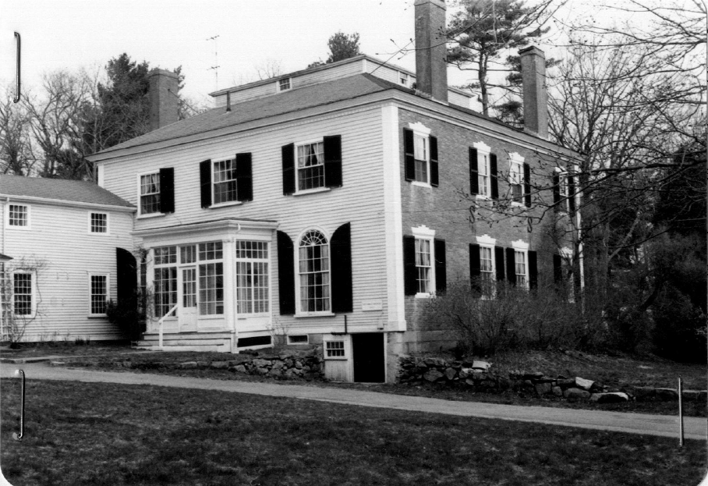
The Moores
Photo from 1910 “bird book,” Massachusetts State Library
William Moore (1846–1914)
Duxbury native, son of Rev. Josiah Moore (who married Sylvanus & Judith Smith)
Partridge Academy/Harvard/US Navy
MA State Rep
MA Men’s League for Woman Suffrage
942 Tremont Street, Duxbury, Bradford-Moore house (1807).
Photo from MACRIS, DUX.3.

Slide 4
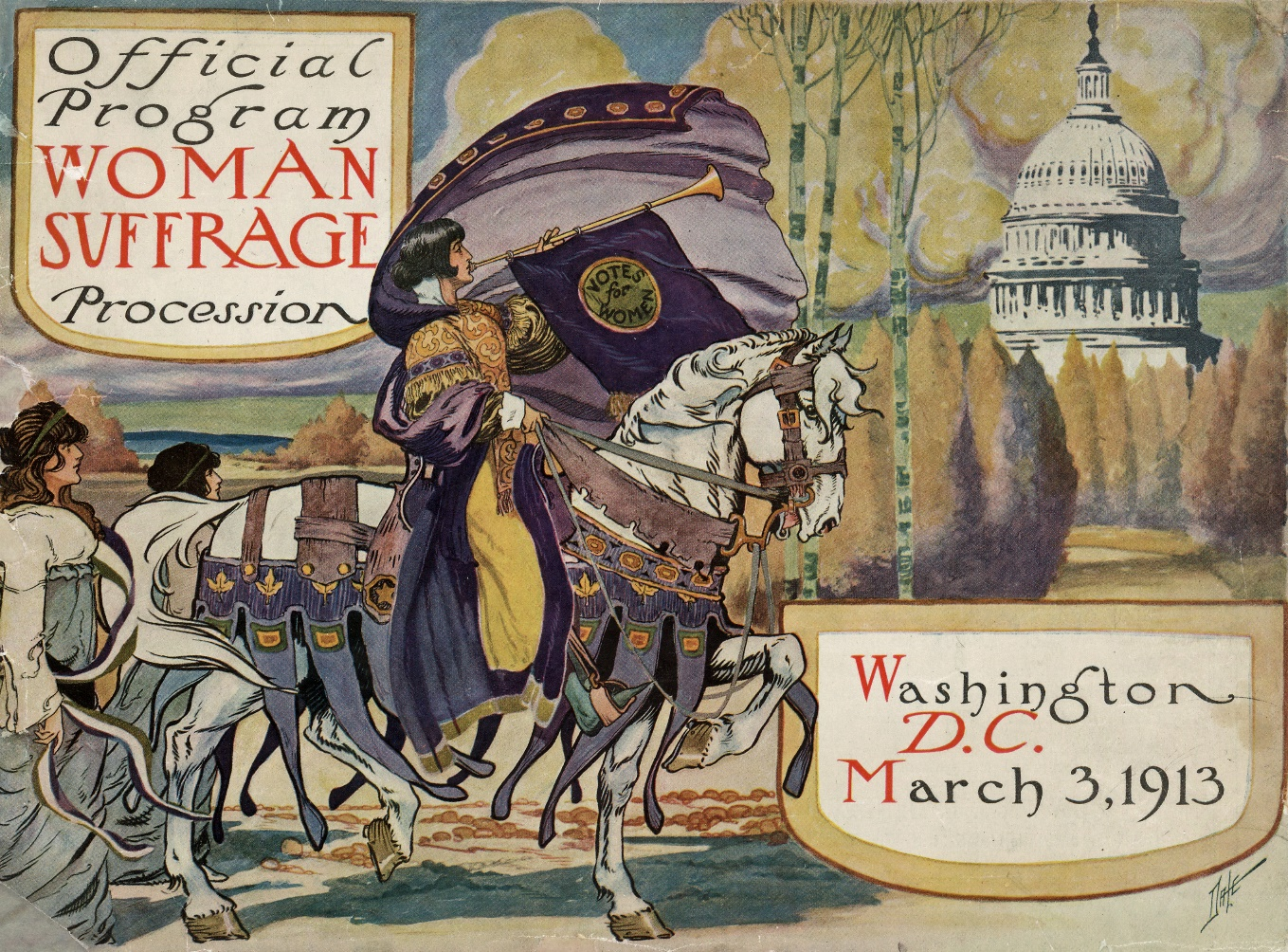
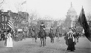
The Moores
Caro Moore and Mary Moore Forrest
Key roles in 1913 Woman Suffrage procession in Washington, DC
Mary a leader of NWP into 1940s
Photos from Library of Congress

Slide 5
Sylvanus Smith (1817-1901) & Judith Smith (1821-1921): nationally significant suffragists
Photos courtesy of Duxbury Rural & Historical Society

Slide 6
Judith Winsor (McLauthlin) Smith & Sylvanus Smith – both Mayflower descendants
…. Judith born in Marshfield (Brant Rock), Sylvanus in Duxbury
(612 Washington St., DUX.261; Smith family chronicle. Smiths later at 45 Cedar St., DUX.37)
…. His father was a sea captain, Jonathan Smith
…. Her father was groundskeeper for shipbuilder Ezra Weston
…. She came to Duxbury to teach (see Millbrook School, 5 West St., DUX.608)
1841 Married, First Church (Unitarian)(1840); lived in Duxbury
1844 Moved to Pembroke (see PEM.16 supplement; NW of Kings Highway Inn, PEM.39)
1854 Moved to East Boston (56 Eutaw Street)
1872 Moved to 76 White Street, East Boston (BOS.14278)
…. Became followers of Theodore Parker (see 9 Appleton St, BOS.tbd)
c1873- Summers in Scituate (SCI.110, SCI.519, etc.)

Slide 7
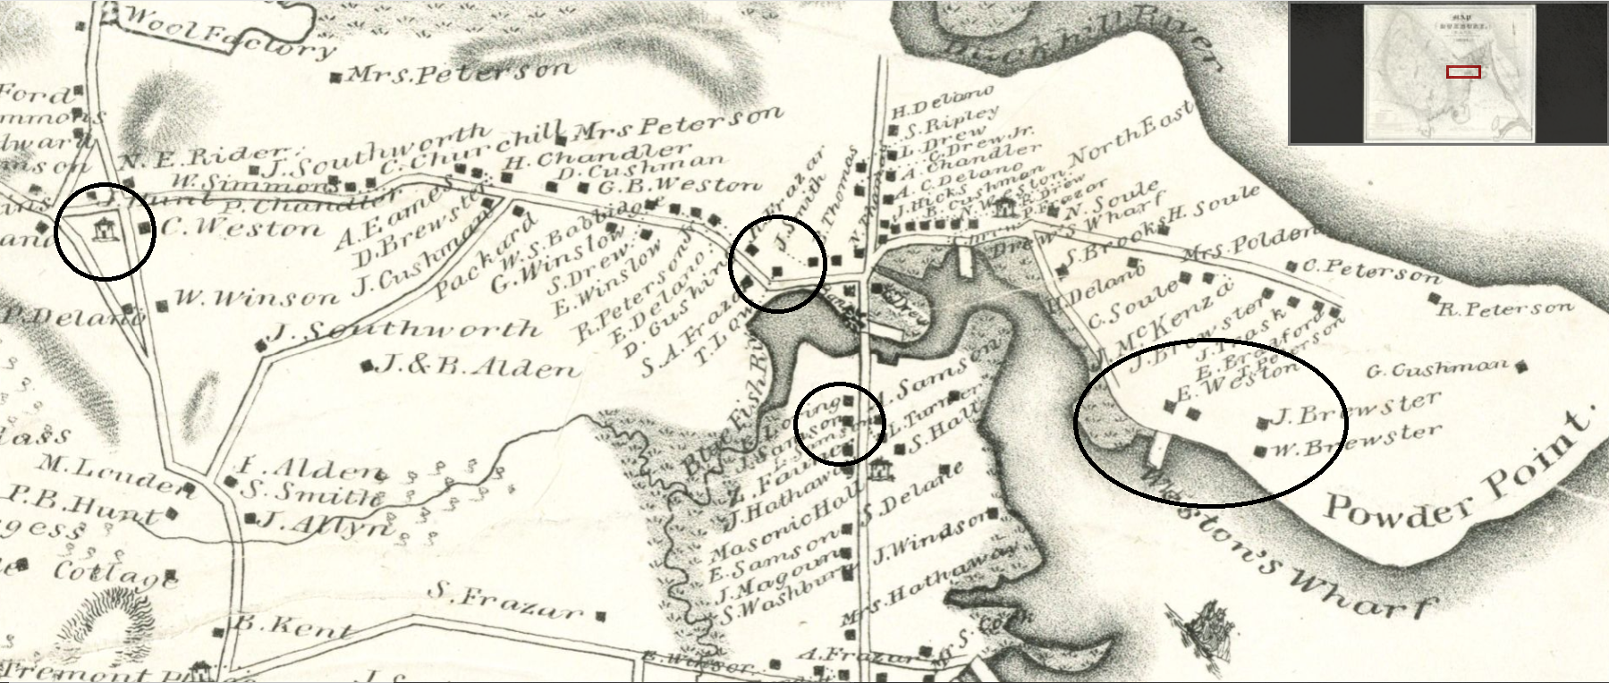
John Ford, Jr., 1833 map of Duxbury, detail, courtesy of BPL/Leventhal Map Center
Circled (L to R): Millbrook School, Smith house (45 Cedar), Sampson boarding house (612 Washington), Ezra Weston property

Slide 8
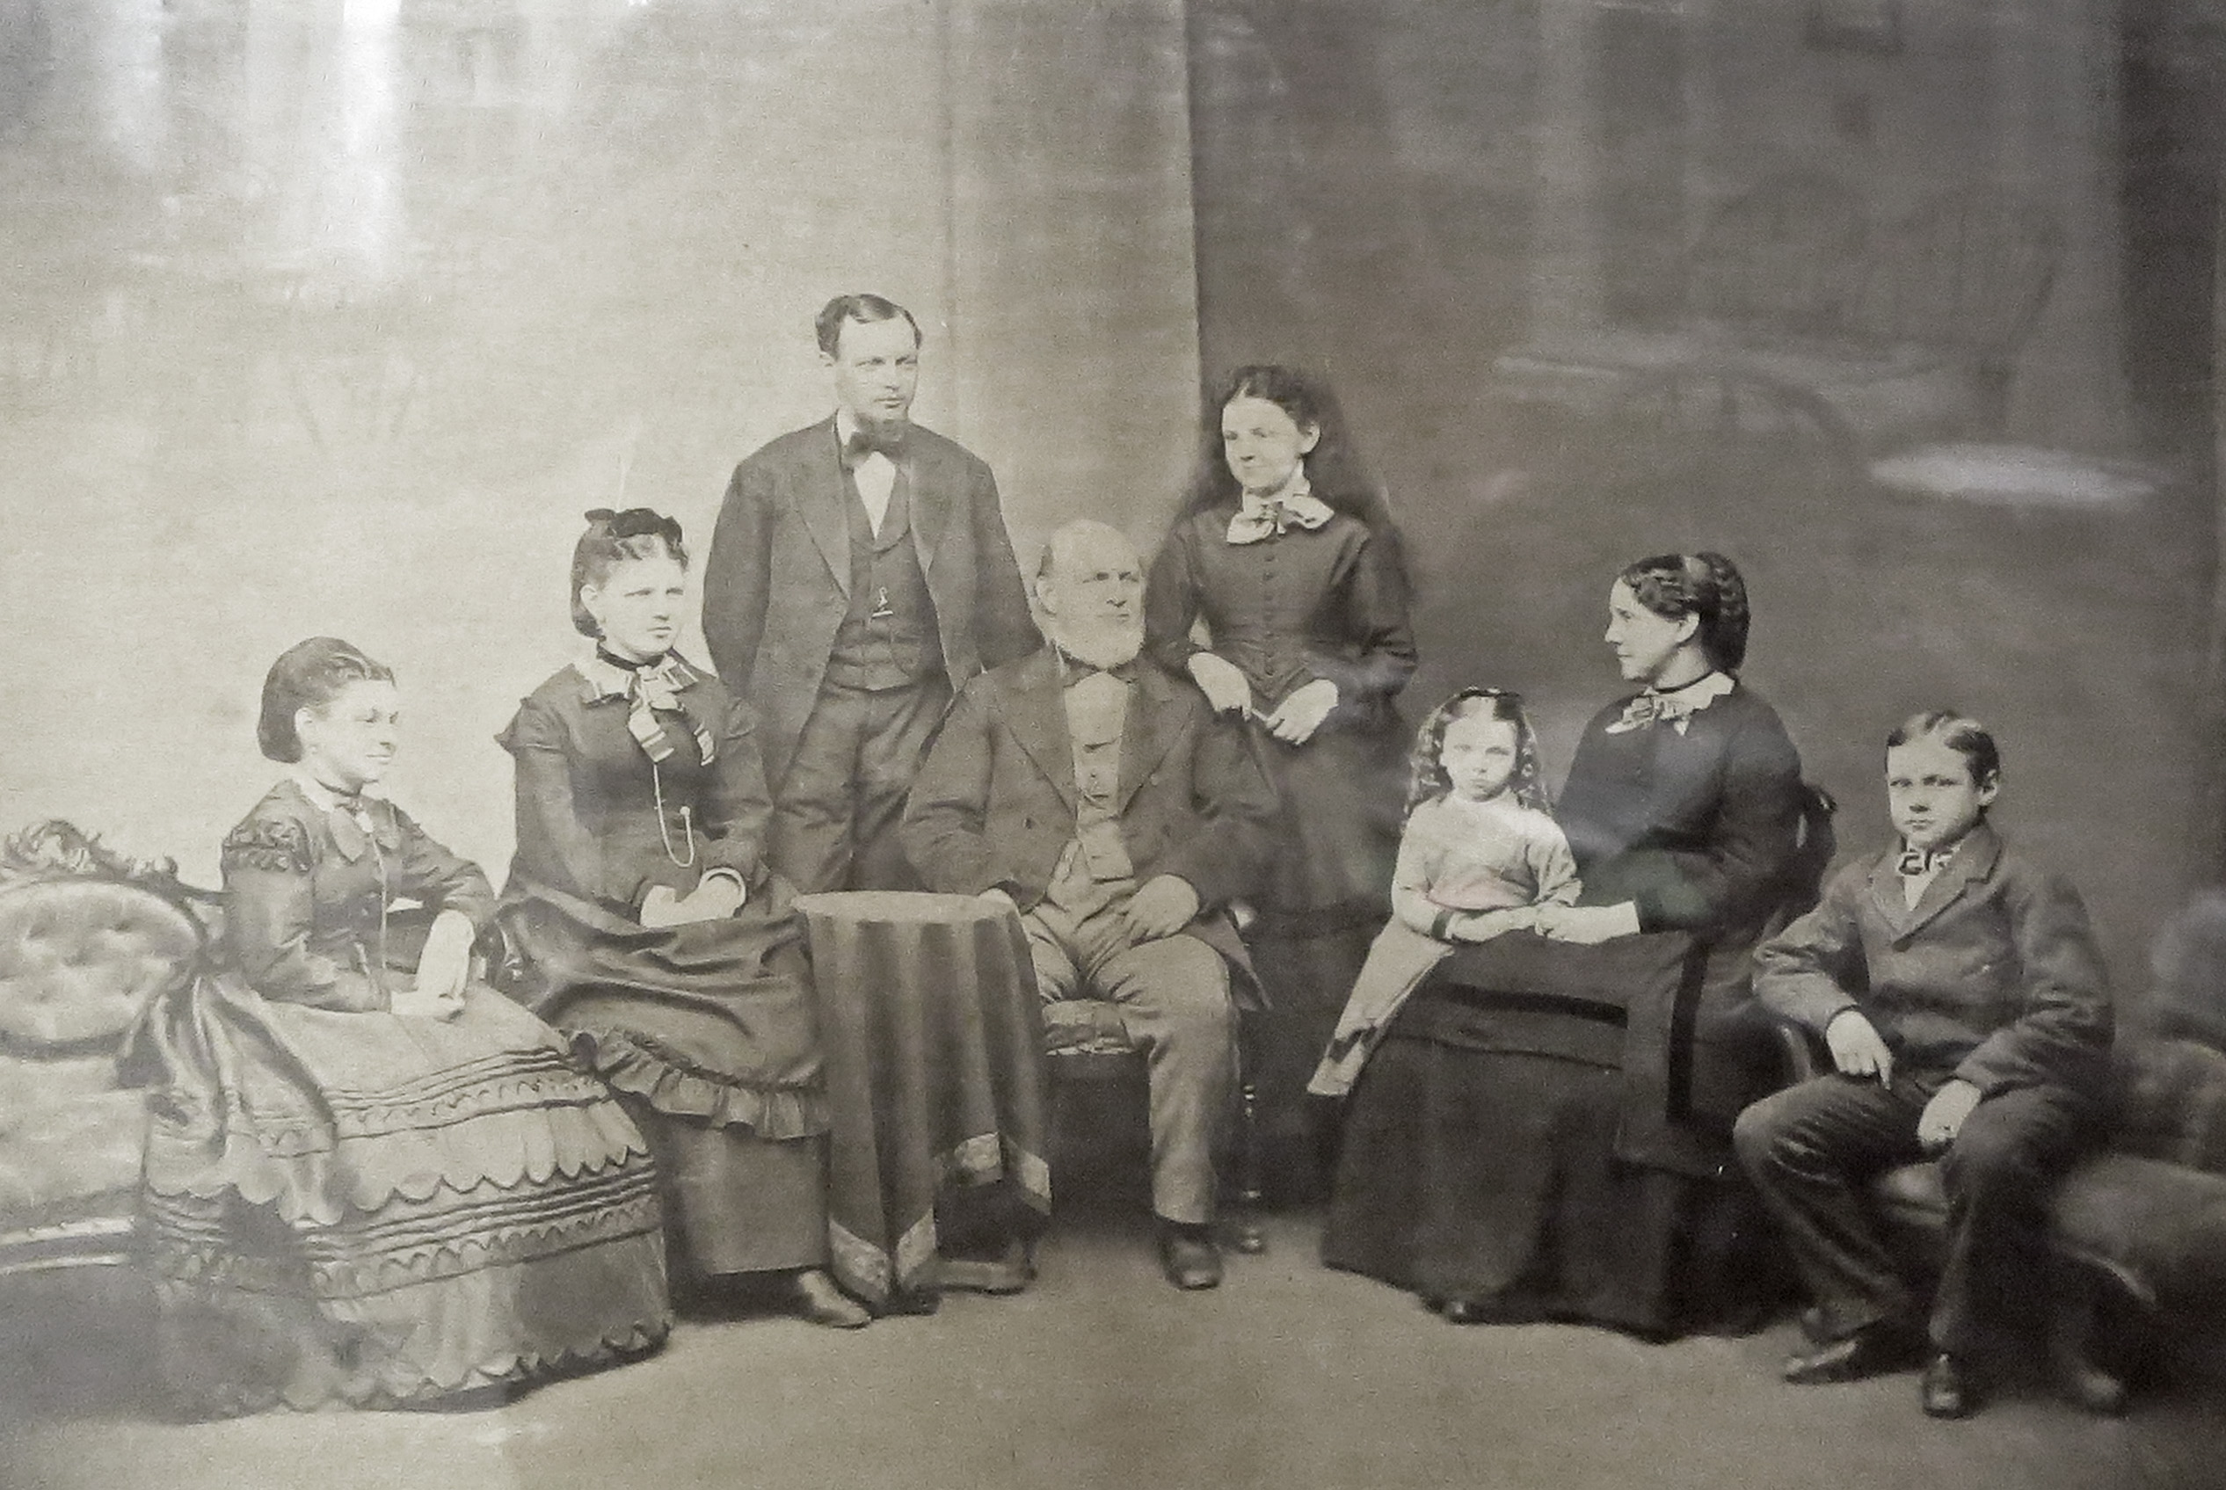
Photo courtesy of Duxbury Rural & Historical Society.
Youngest child Jennie was born in 1865.

Slide 9
Key Shipbuilders of East Boston
Donald McKay (Canada) 1845-1869
78 White St. (1844)
Samuel Hall (Marshfield, Duxbury) 1839-1870
199 Webster St (Jeffries Point) (1853)*
Paul Curtis (Scituate, Medford) 1851-1873
402 Meridian St. (r1860)
Sylvanus Smith (Dux., Pmbrk, Medfd) 1854-1884
Moved to East Boston 1854
Became Samuel Hall’s foreman
Related by marriage to Samuel Hall
Later partnered with Curtis6 Eutaw St. (1854) & 76 White St. (1872)
* Thanks to Terrace-Place.com (1853 purchase), and MACRIS, BOS.AFD (1837-1851 built)

Slide 10
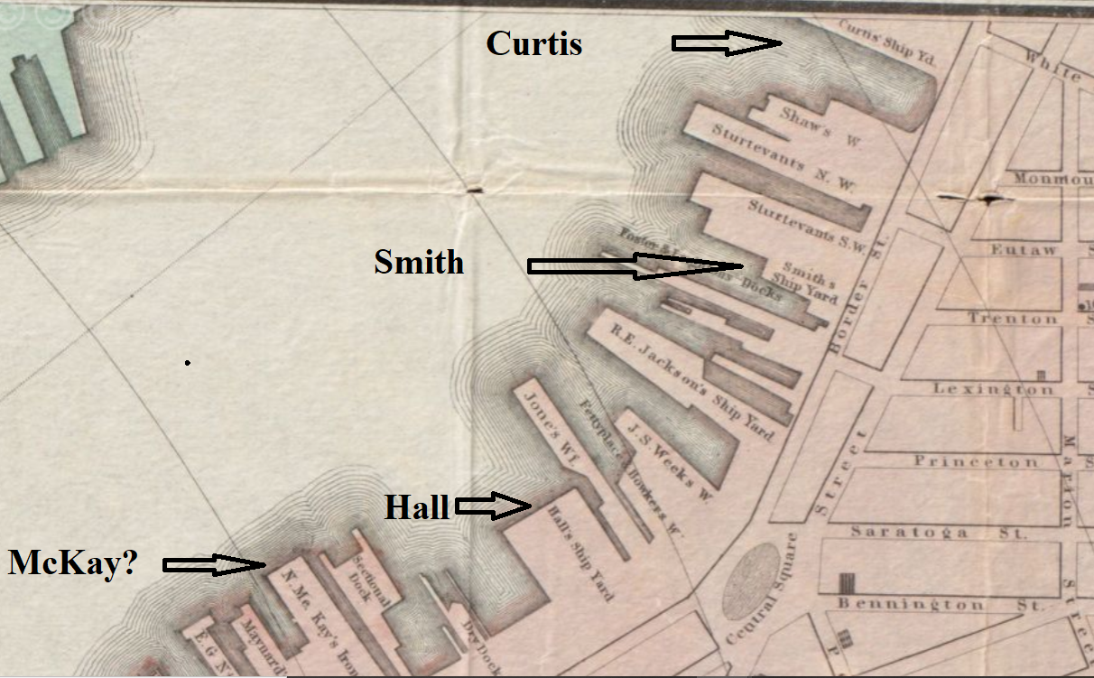
1866 map, detail
Curtis yard at foot of White Street, where Smith and McKay lived
Smith yard nearby
Hall yard (same site)
McKay yard (later site)
Crafts, Wightman, Swett, and Boston Engineering Dept., Leventhal Map Center, BPL

Slide 11
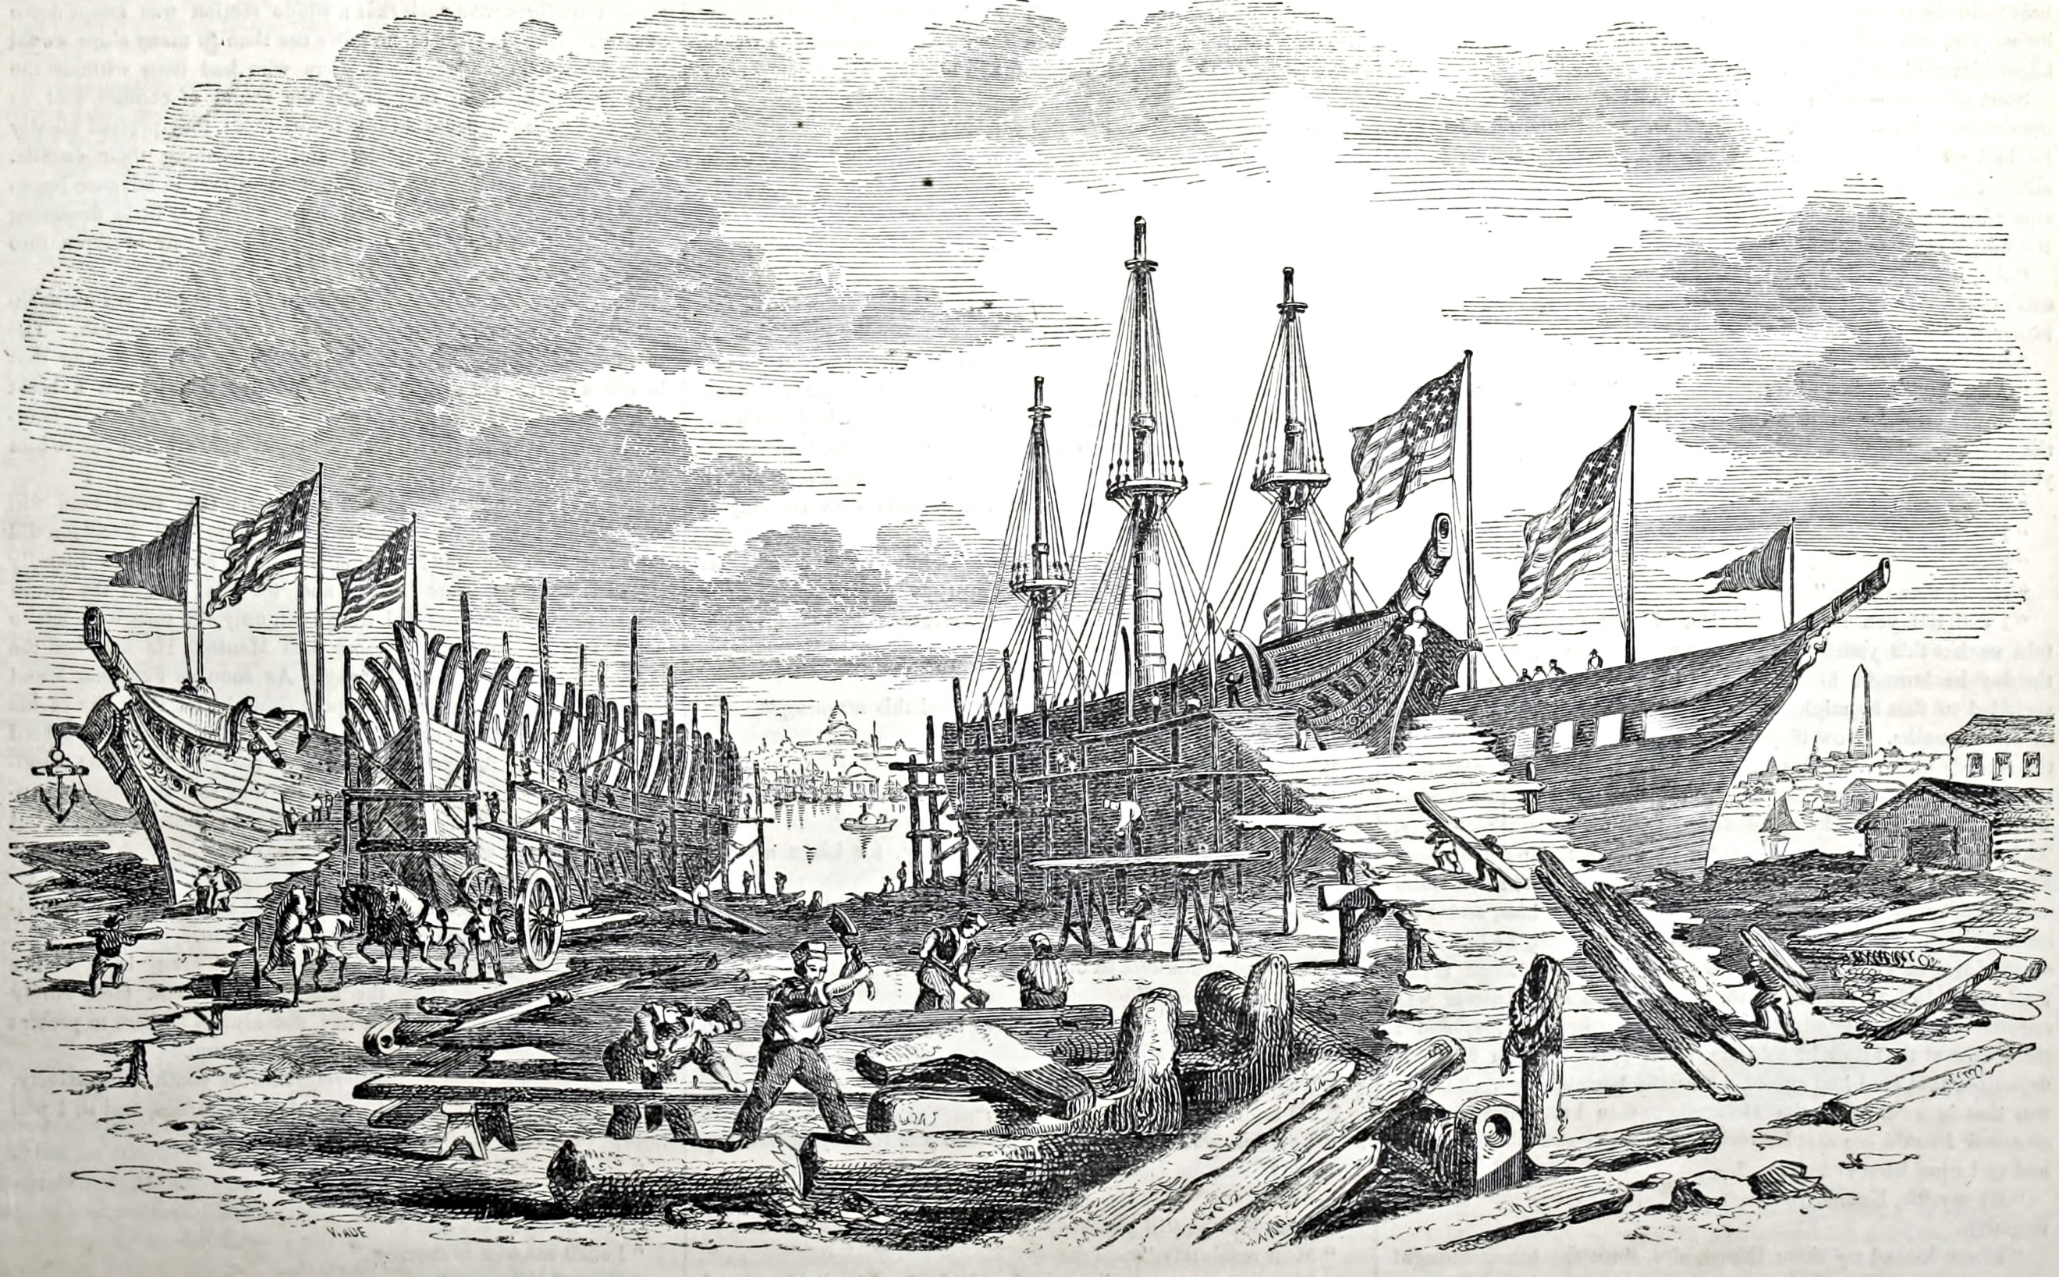
“a glorious rivalry among the builders”
Ballou’s Pictorial,
May 19, 1855, 305

Slide 12
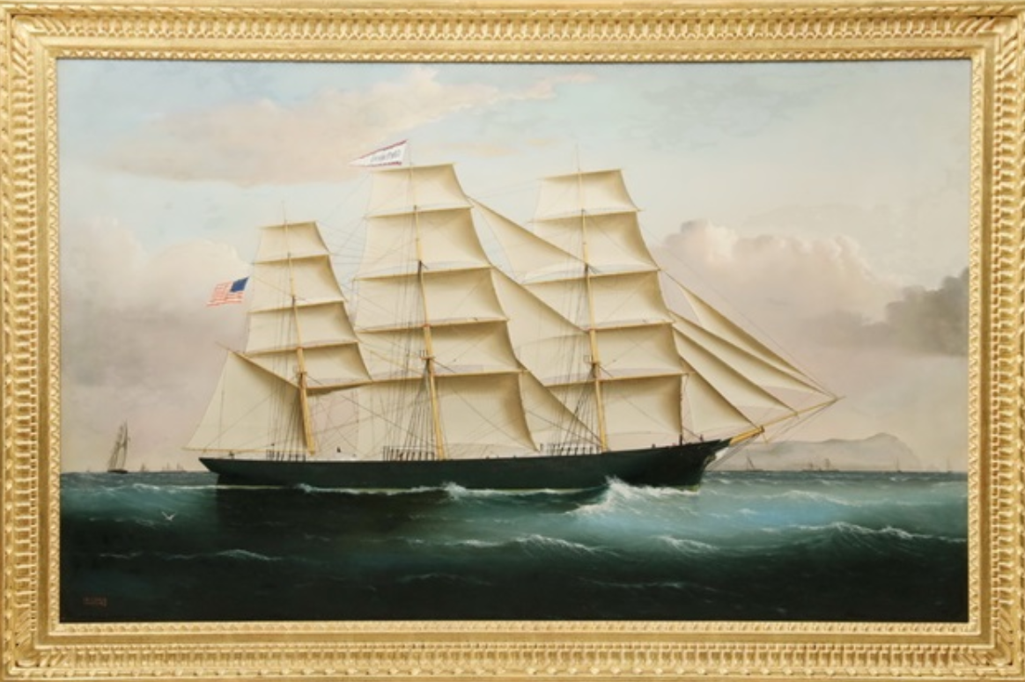
The Centennial, built 1875 by Sylvanus Smith (Smith & Townsend)
Philadelphia (see book)
England (shown)
Hong Kong (oil painting was in family)
San Francisco (figurehead by Gleason is in Fine Arts Museums of San Francisco)
Artist: William Howard Yorke. ArtNet photo.

Slide 13
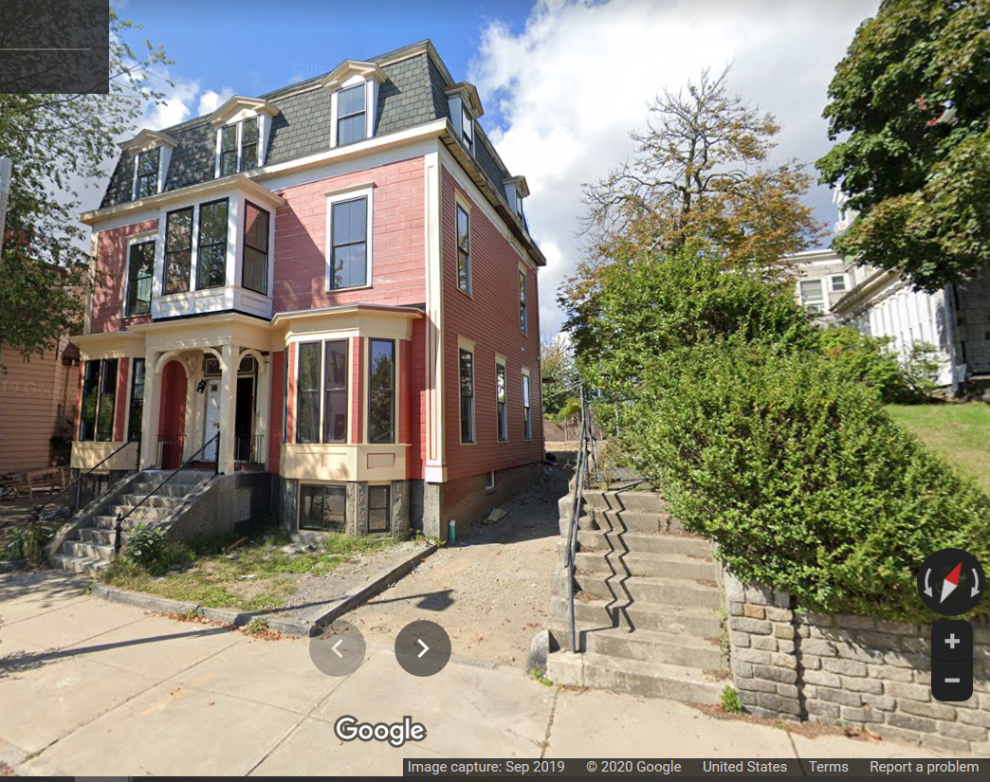
Smith and McKay Houses
Smith house (1872),
76 White Street
(Second Empire style, BOS.14278)
McKay house at right
Google Street View, Sep 2019

Slide 14
Suffrage Timeline
1830s Judith & mother early suffragists
1862 Judith & Sylvanus – antislavery advocates;
(later, friends with William Lloyd Garrison’s son)
1870 15th Amendment gave African American men the vote
1870 Lucy Stone founded Woman’s Journal in Boston; in 1876, Judith & Sylvanus’s niece Catherine “Kate” Wilde of Duxbury began work there
1878 Sylvanus an officer of E Boston Woman Suffrage Club; Judith at national suffrage organizations in Boston
…………..
1913 Suffrage parade in Washington, DC
1915 Boston parade; referendum on women’s right to vote
1917 Suffrage “silent sentinels” & picketing at White House
1920 19th Amendment gave women the vote

Slide 15
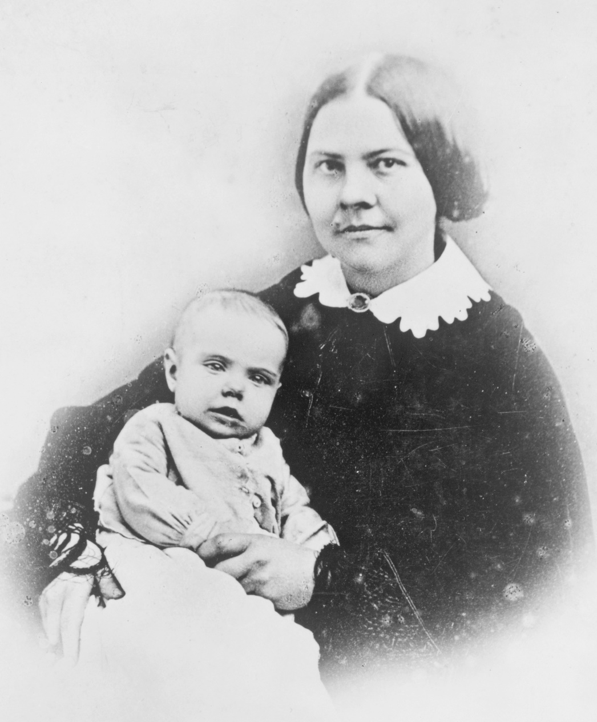
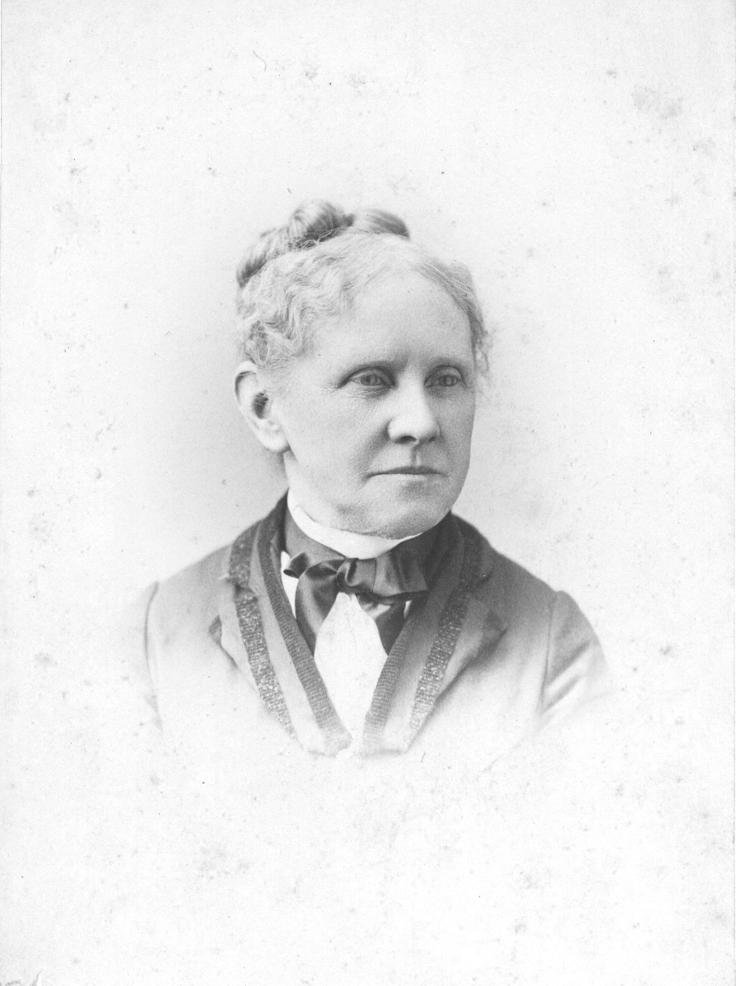
Suffragists
Lucy Stone (1818-1893) & ASB (1857-1950), c1858, LOC, public domain
Judith W. Smith (1821-1921), late 1800s. Courtesy of Duxbury Rural & Historical Society.

Slide 16
Judith Winsor Smith
1875, founded Home Club of East Boston, the second women's club in Massachusetts, and served as its president for ten years; Julia Ward Howe and Mary A. Livermore spoke there
By 1881, member of the Massachusetts Woman Suffrage Ass’n
President of the East Boston Women's Suffrage League, honorary vice president of the New England's Women's Club
Member, executive committees of the Massachusetts, New England, and American Women Suffrage Associations
In 1899, Judith presided over the Massachusetts Woman Suffrage Association, and was elected Massachusetts member of executive committee of the National American Woman Suffrage Association (NAWSA)
1915, still campaigning for women’s right to vote. Met Curley.
1921, met Pres. Harding. What dedication & persistence in the cause!
"the world's oldest
suffrage orator"

Slide 17
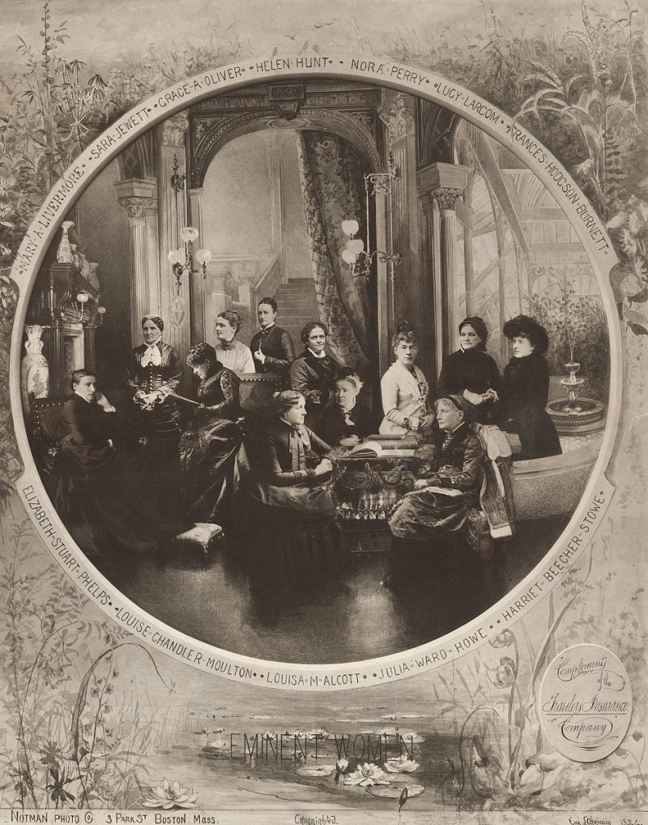
12 Eminent Women
Mary A. Livermore, … Louisa M. Alcott,
Julia Ward Howe …
Mary – Duxbury connection (teacher, husband)
Mary & Julia – suffragists, and friends of Judith Smith
Julia & Louisa – members of Parker’s 28th Cong. Society of Boston, with Judith and Sylvanus Smith
Artist: Eugene L'Africain, for Notman Photographic Company, photo composite (1884). National Portrait Gallery, Smithsonian Institution, https://www.si.edu/object/npg_NPG.81.51.
See The Library Company of Philadelphia, https://librarycompany.org/portfolio-item/2016-eminent-women/.

Slide 18
Parker Memorial Building, Boylston & Appleton Streets, Boston (built 1872). New York Public Library (edited for clarity), probably before 1895.

Slide 19
3 Park St, Boston, home of Woman’s Journal (founded 1870) and suffrage organizations (to 1902, WJ to 1908)
3-5 Park St, c 1903, E. Chickering & Co. photo, courtesy of Library of Congress

Slide 21
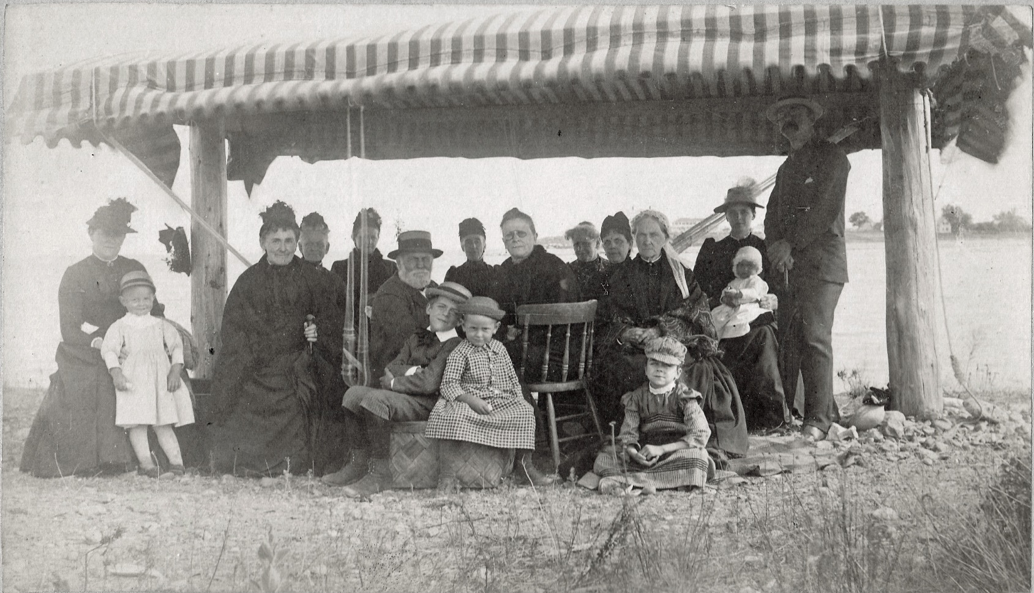
Clara Drew Smith (1830-1911), widow of Capt. Jonathan Smith, behind chair, and her grand-daughter Helen Clapp, on ground, bottom right
Smiths with friends from Duxbury.
Photo courtesy of Duxbury Rural & Historical Society.

Slide 22
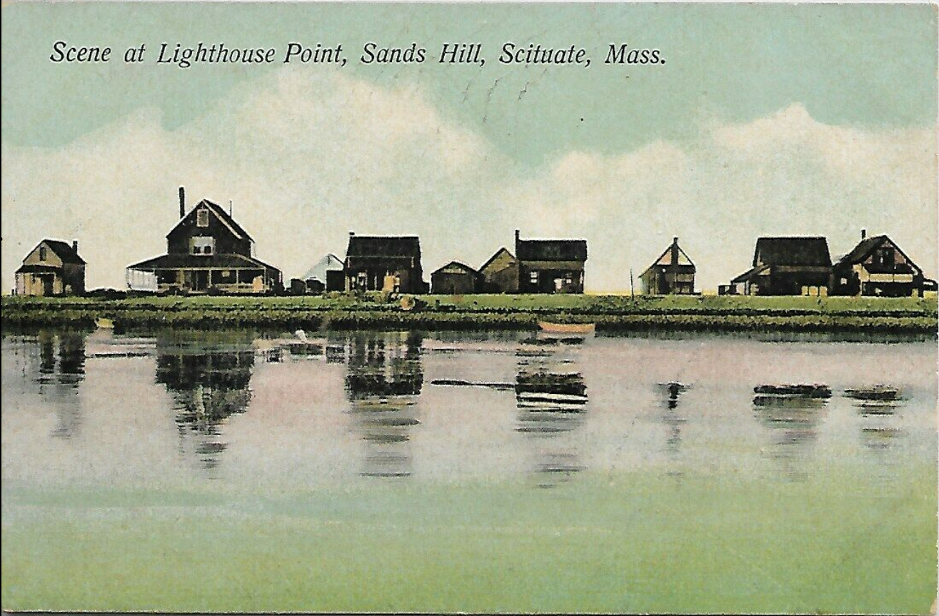
Smith Cottage (built 1896), 2d from left.
Postcard from author’s collection.

Slide 23
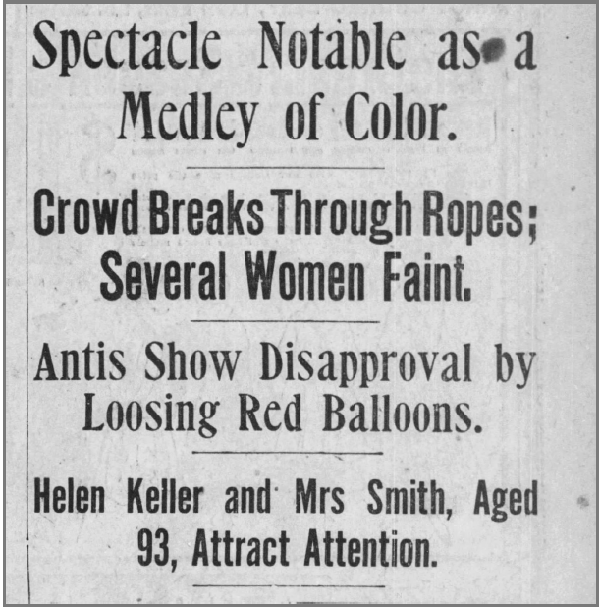
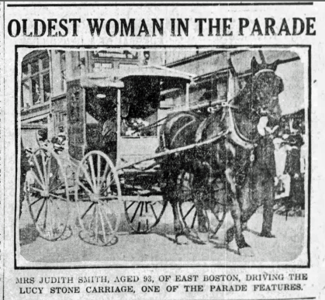
1915 Suffrage Parade in Boston, Boston Globe pages 1 & 10

Slide 24
Judith Smith gets the vote (Excerpts from Boston Globe article, August 29, 1920, 61)

Slide 25
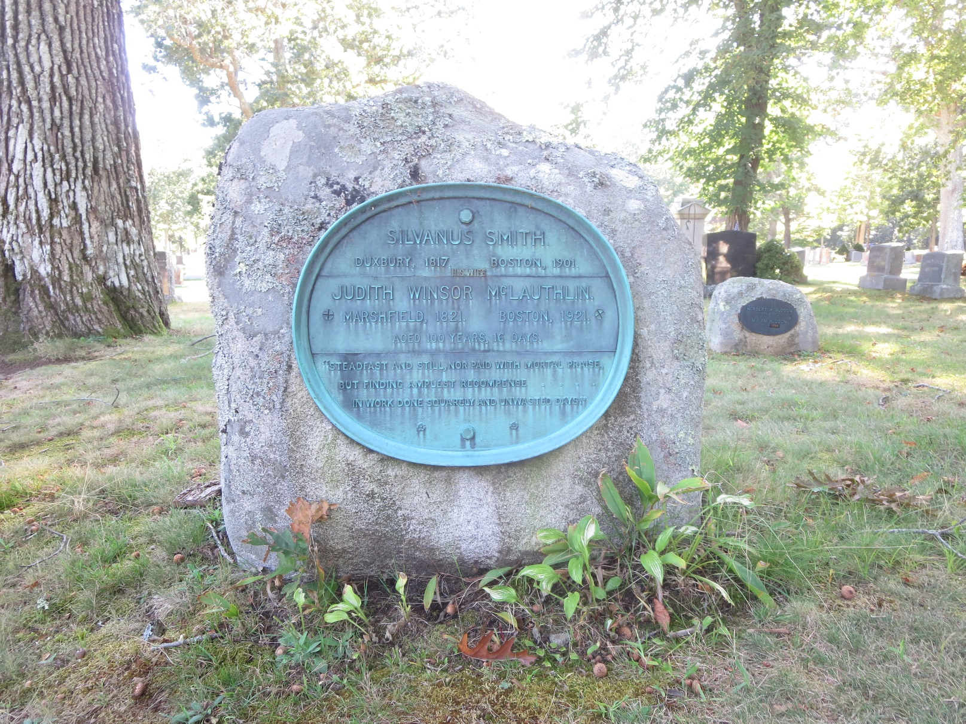
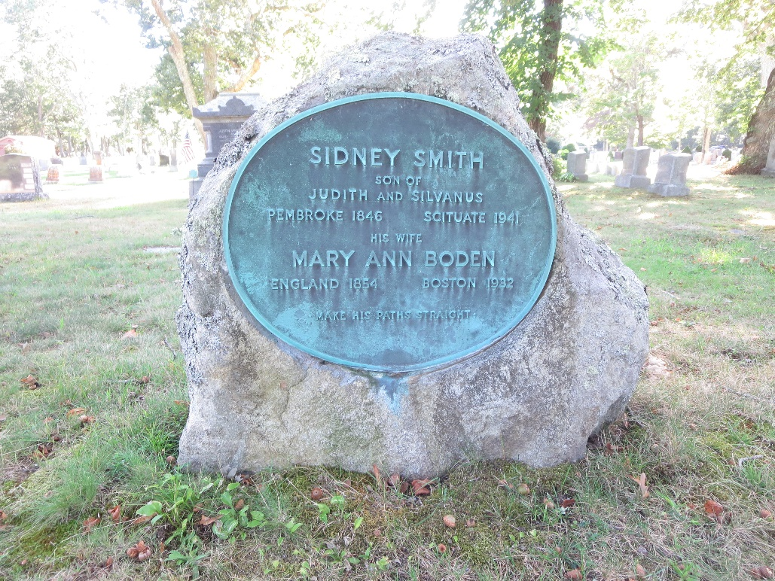
Mayflower Cemetery, Duxbury

Slide 26
Conclusions
The Smiths were key suffragists from Duxbury/East Boston/Scituate
The Moores were key suffragists from Duxbury/Washington DC/Scituate
Judith Smith persisted in the fight for women to vote, 1870s to 1920

Slide 27
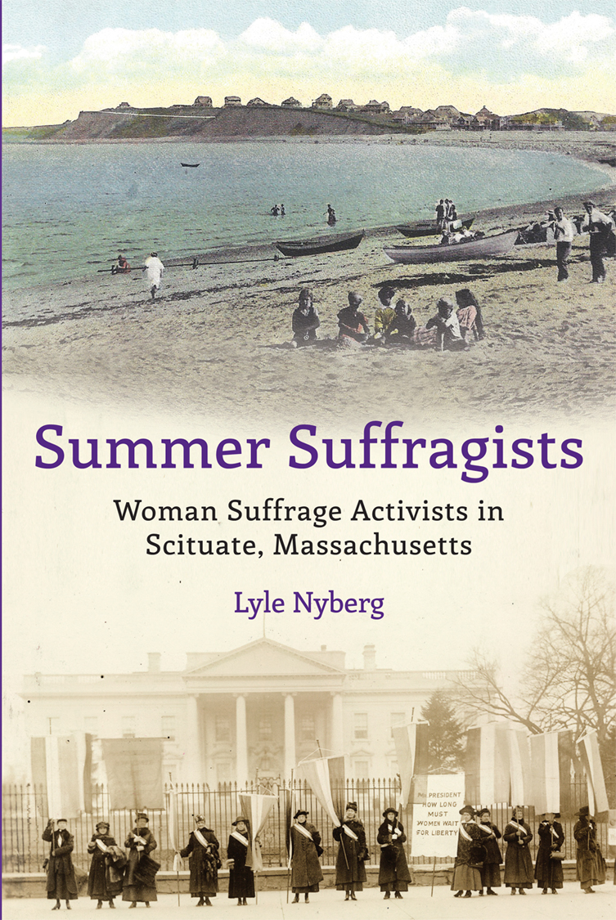
Book available on Amazon
& Buttonwood Books, Cohasset
More information:
Google “Judith Winsor Smith”
Patriot Ledger, Aug. 18, 2020, Sue Scheible, “South Shore women helped lead the way to suffrage”
DRHS and MHS collections
Contact me at my website
www.lylenyberg.com

